Slide 1
WEEE Ireland
What Do They Do???

Slide 2
About WEEE Ireland
WEEE Ireland is a non-profitable organisation who aims to decrease the amount of waste from electrical appliances, batteries and electronics.

Slide 3
The Purpose
WEEE Ireland and other companies with their purpose use old/broken electrical appliances for circuit boards, wires and other pieces of re-usable parts to fix and re-use instead of wasting them and adding to the vast amounts of landfill from un-recycled items.

Slide 4
The Good and The Bad
If we continue to put our electrical items to waste there could be extreme damage to the environment and our atmosphere, causing toxic air and other problems.
However if WEEE continues their work there could be many upsides such as: less landfill, cheaper electrical products of the same quality and a better environment in general.

Slide 5
The Founding Companies
Believe it or not WEEE Ireland came to be with the support of electrical companies such as Microsoft, Apple, Panasonic, Dell, Siemens, Sanyo, JVC, Sharp, Whirlpool, IBM and others.

Slide 6
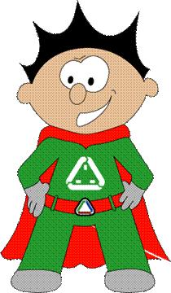
The Mascot
Developed in 2007, Sparky has proved extremely constructive in conveying the message of WEEE Ireland to young and old alike.
He is a key part not only in the presentation to the schools but also in the campaign to raise awareness throughout the entire community by being instantly recognisable as a symbol for good recycling practice.

Slide 7
The link
www.weeeireland.ie

Slide 8
WEEE thank you for watching
From Oisín, Ben and Cillian

